Slide 1

Industry, Technology, Teaching, & Research Colby T. Ford, Ph.D.
UNCC School of Data Science
Associate Professor of Practice Candidate

Slide 2
Industry Experience

Slide 3




Industry Experience
Amissa
VP of Technology
Digital Health Startup
IoT and AI for Neurodegenerative Disorders
NSF I-Corps, NIH SBIR
Edge Systems (HydraFacial)
Director of Data Science
Dermatologic Medical Devices
Cloud Architecture, Computer Vision, IoT
Ember
Chief Data Scientist
AI Startup
NLP for Compliance Use Cases
Current Role:
Artificial Intelligence Architect
( )

Slide 4









































Slide 5
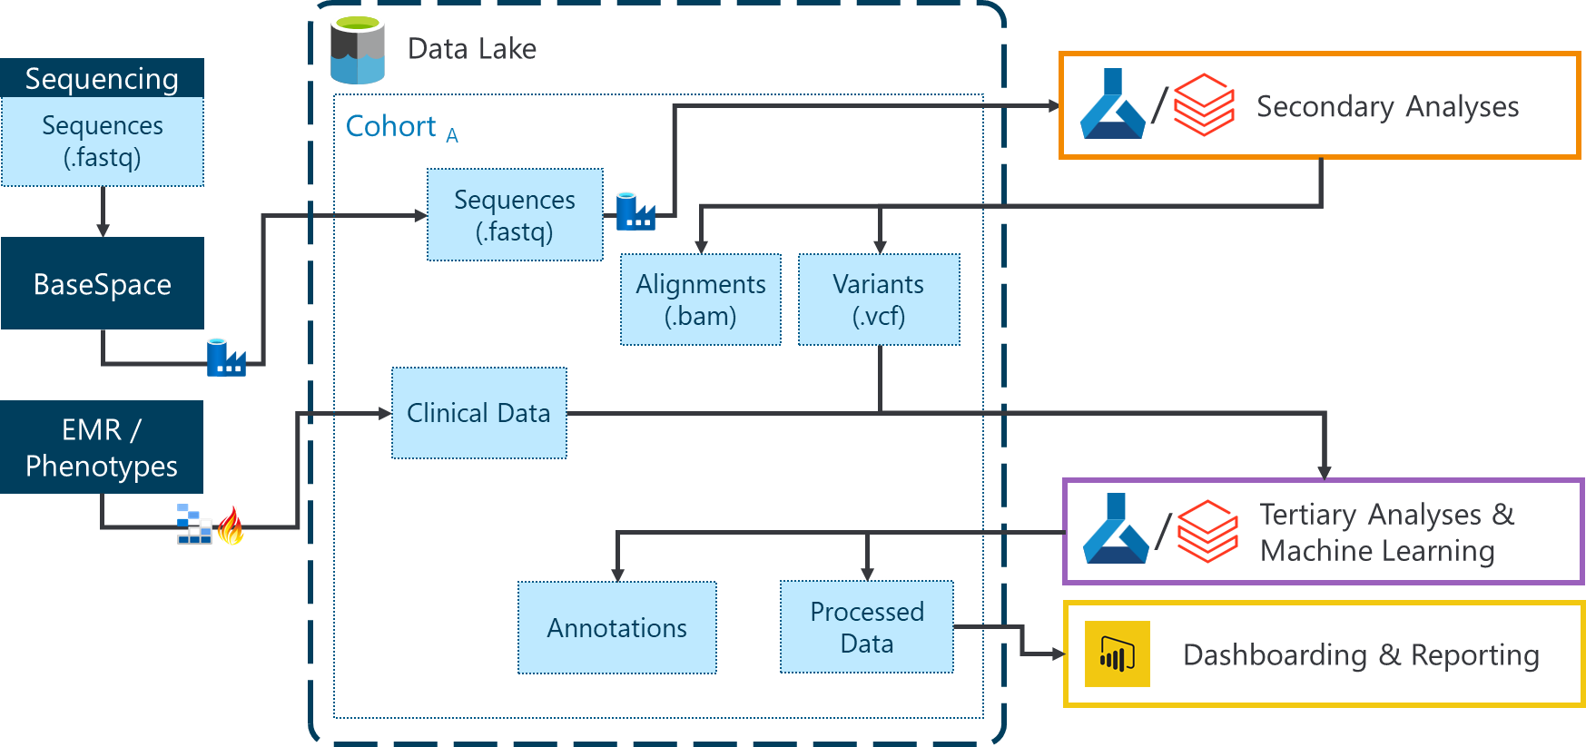
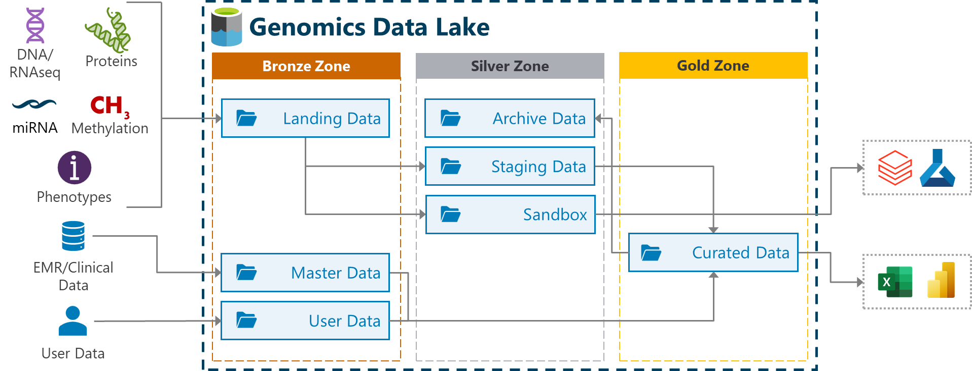
Industry-Specific Cloud Architectures
Features:
Scalability (400TB)
Security (RBAC, ACL)
Compliance (HIPAA, ISO)
Automation
Collaboration

Slide 6
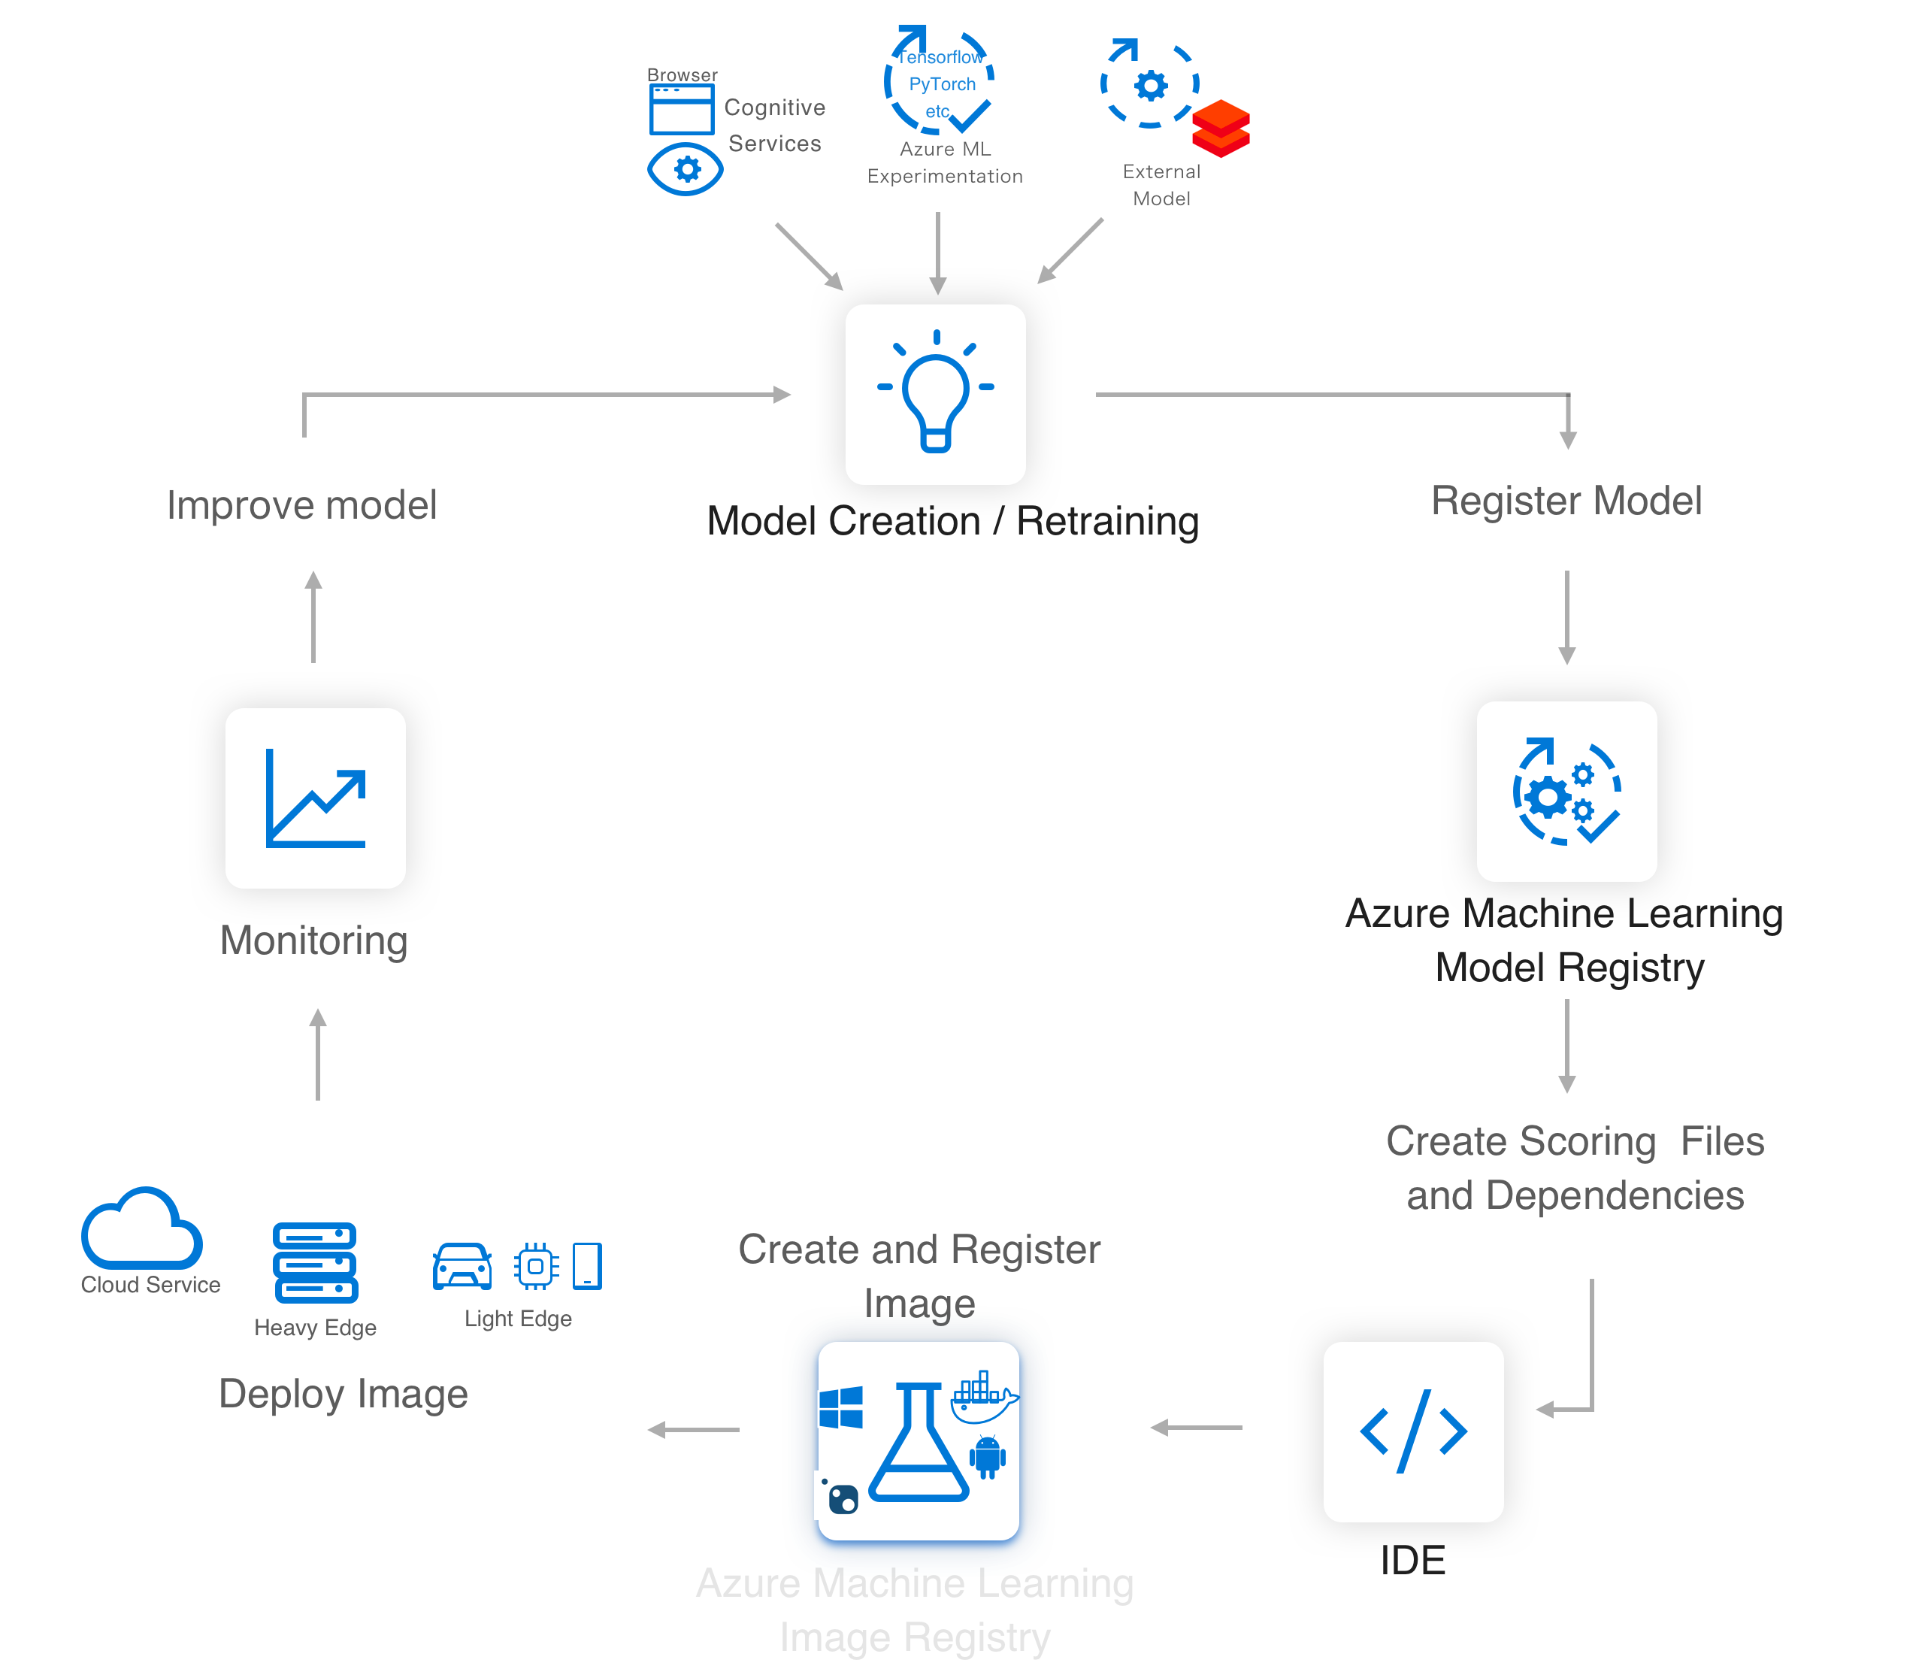
Cloud-Based ML Lifecycle
Scale and Rigor
Operationalization
Automation/MLOps
Access to Data
Distributed Training
Collaboration
Deployment as Batch Scoring
Deployment as REST API
Containerization
Data Drift Detection
Model Maintenance
Explainability
Fairness
Automated Retraining

Slide 7

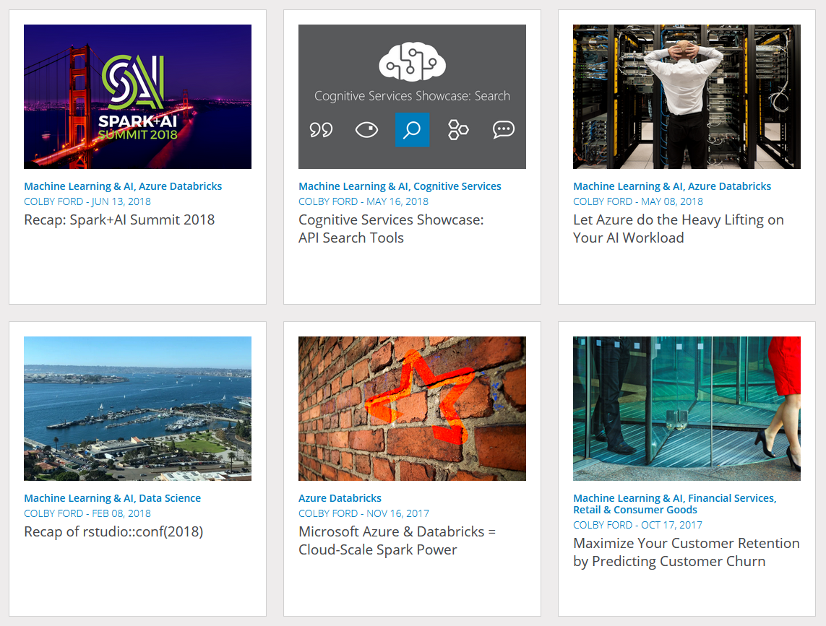
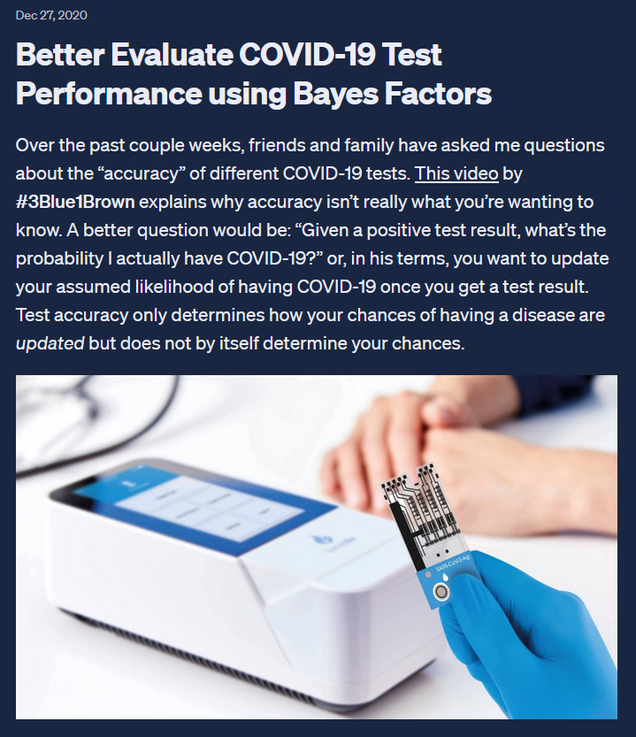
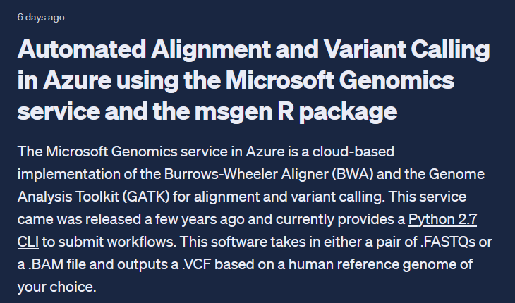


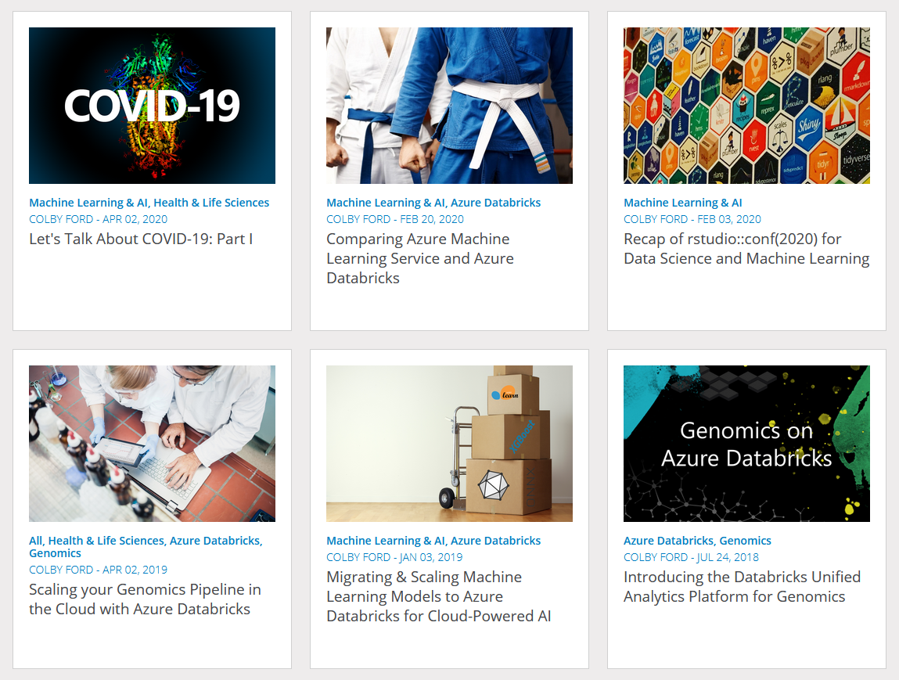

Thought Leadership
MS Learn – Azure Data Scientist
Exam Writer
Microsoft DP-100 Exam Writer

Slide 8
Academic Experience

Slide 9


Academic Experience
Teaching:
LEVEL Program – Machine Learning
Research:
Machine Learning
Cloud Computing
Visualization
Human Phylogenetics
Infectious Disease Genomics
Teaching:
DSBA 6190 – Cloud Computing
Other Activities:
Research Interns (4 Graduate, 2 UG)
DSI Advisory Board
Teaching:
NCVPS – Advanced Functions and Modeling (Math 4)
Other Activities
Technology Management
Student Records Admin
Tutoring for College Courses

Slide 10
Research Examples

Slide 11
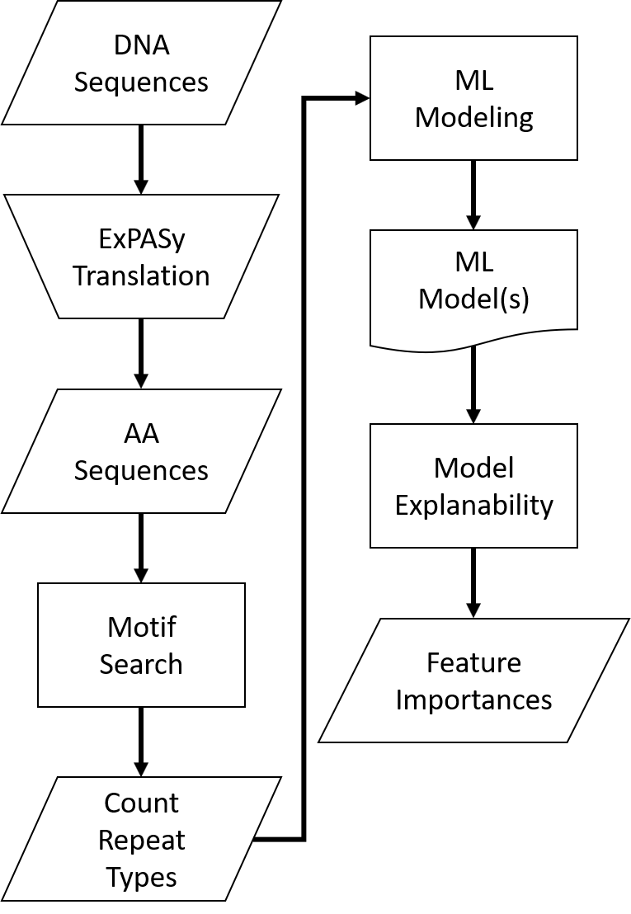
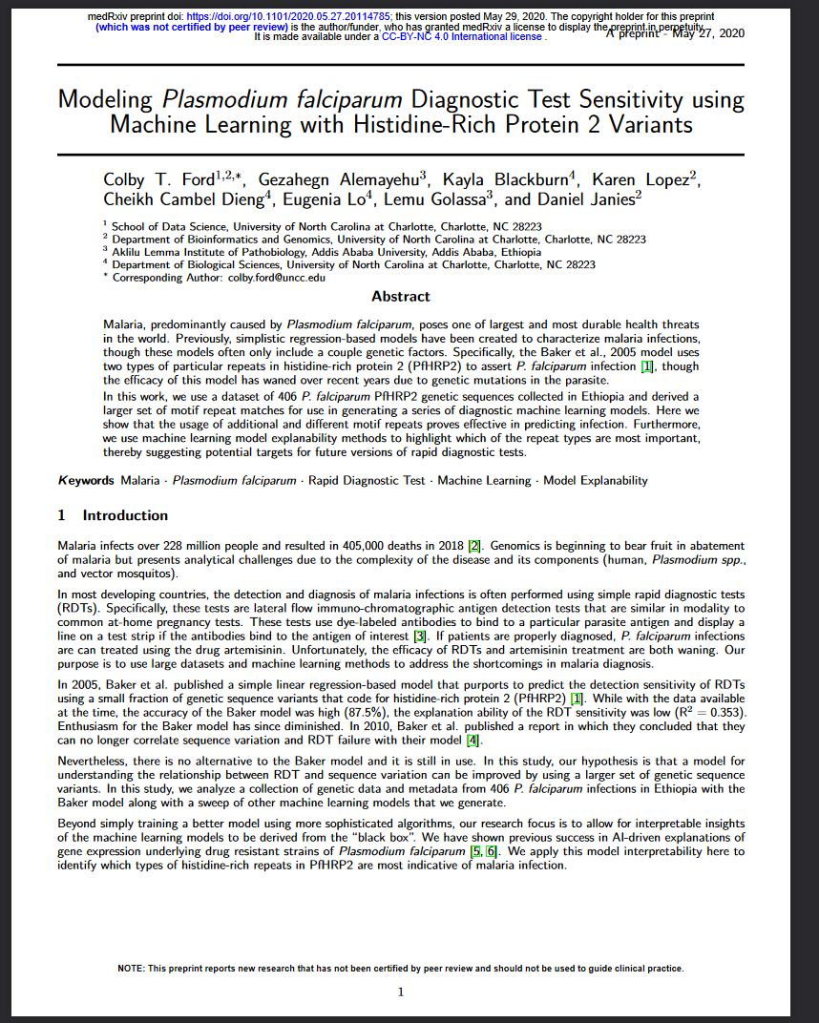
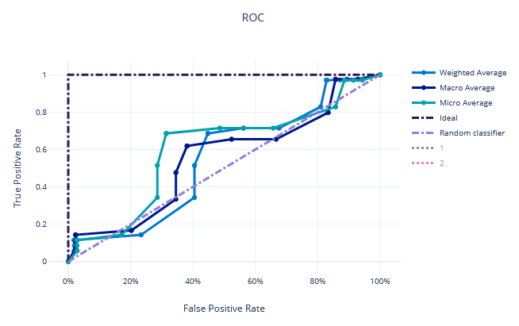
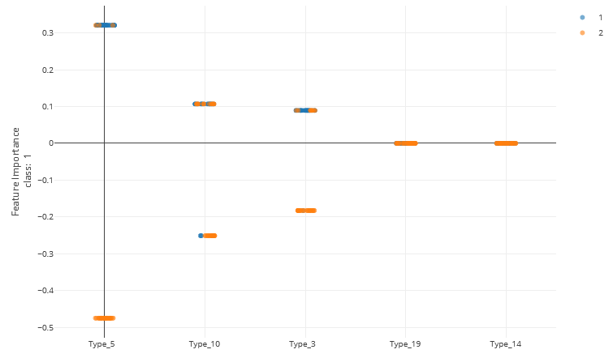
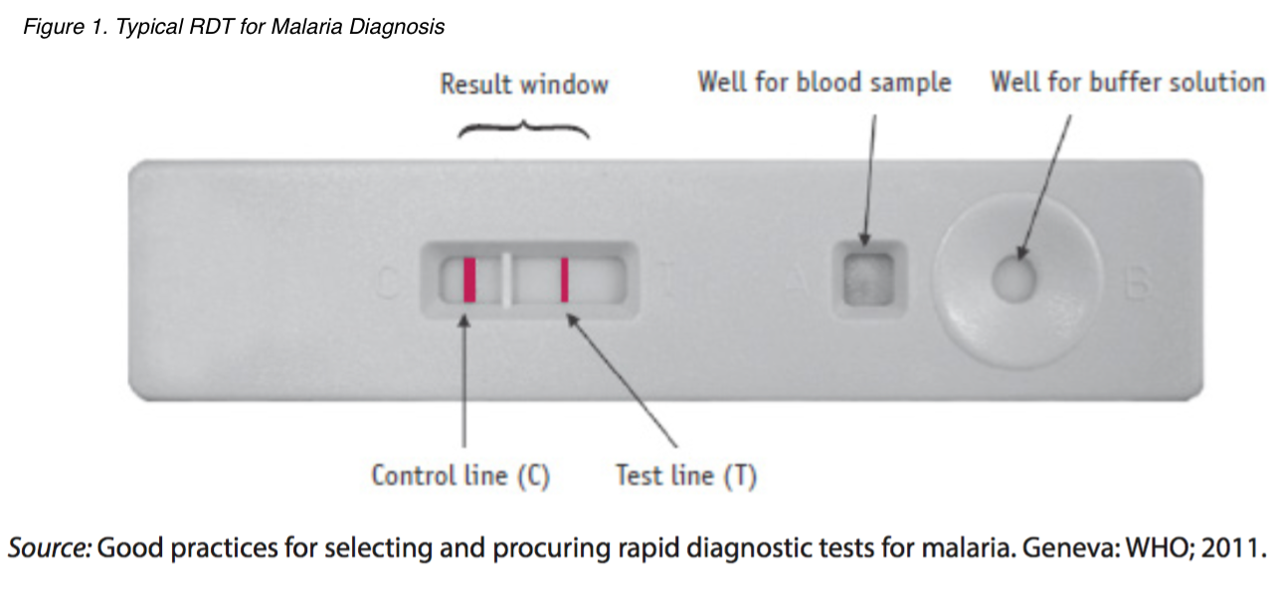
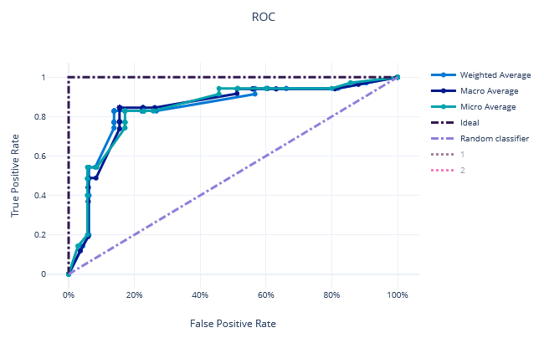
Explainable ML for Malaria Testing 🦟
Ford et al. (2021)

Slide 12
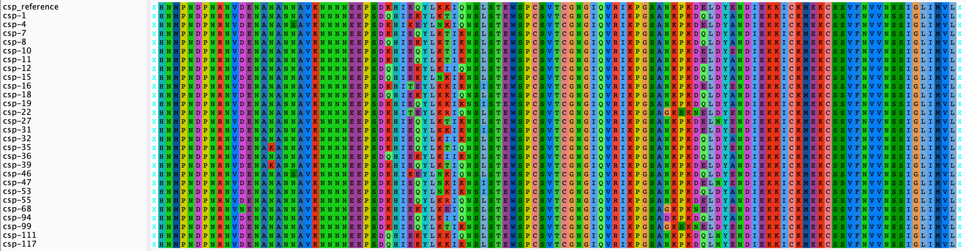
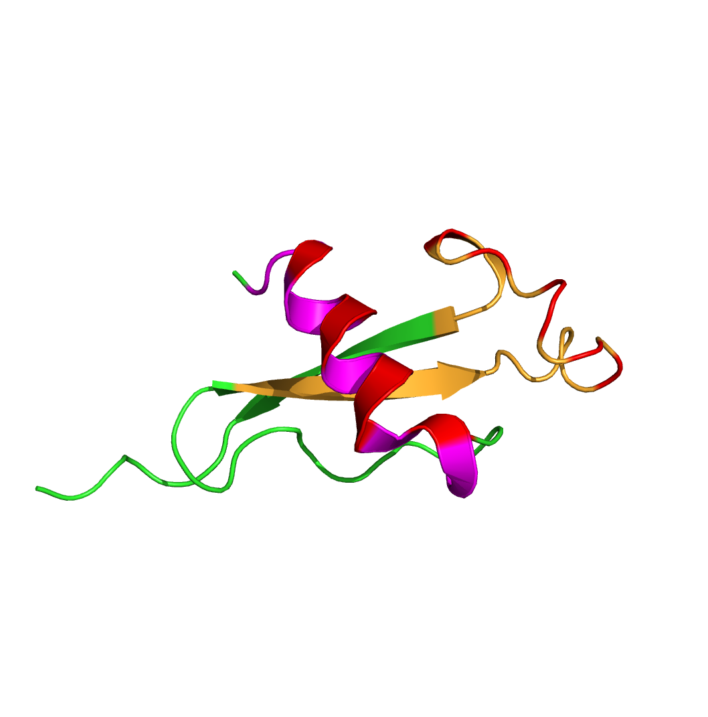
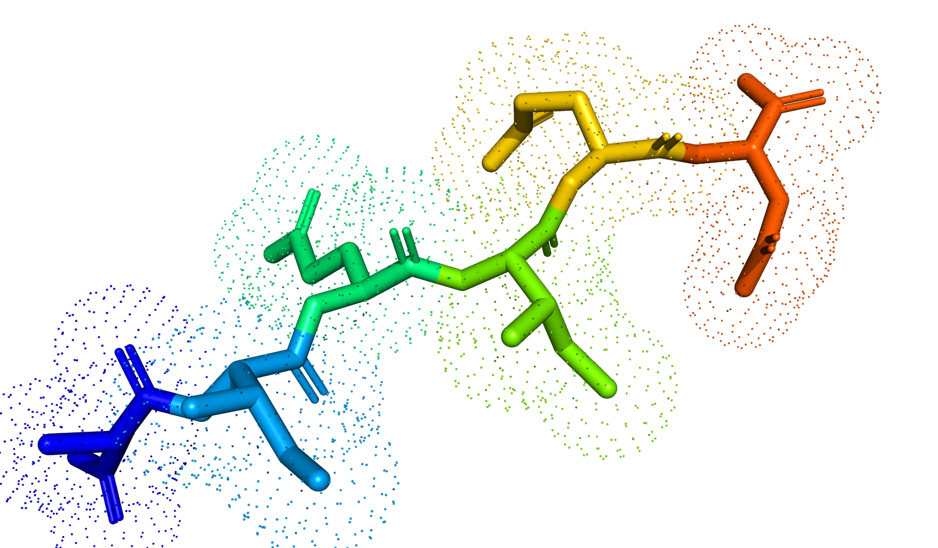
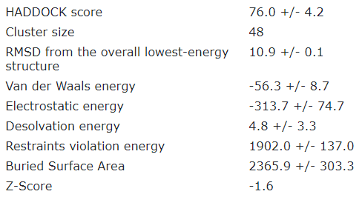

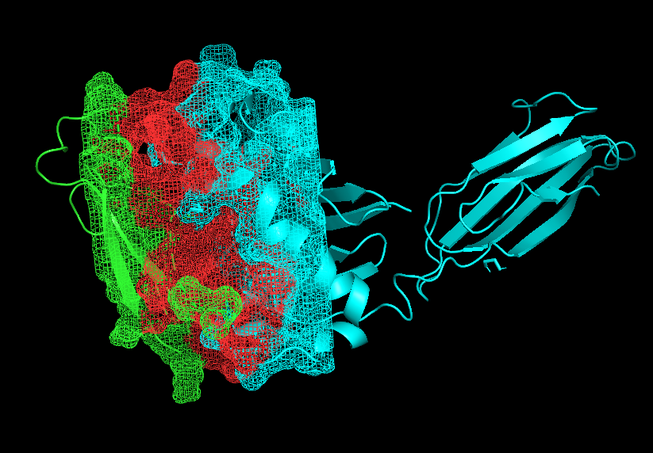
Deep Learning for Vaccine Efficacy P. falciparum RTS,S Vaccine from Ghana
Sequence-to-Structure
Proteasomal
Degradation
Docking with Human
T-Cell Receptor
Dieng and Ford et al., (2021)
In Review and Ongoing

Slide 13
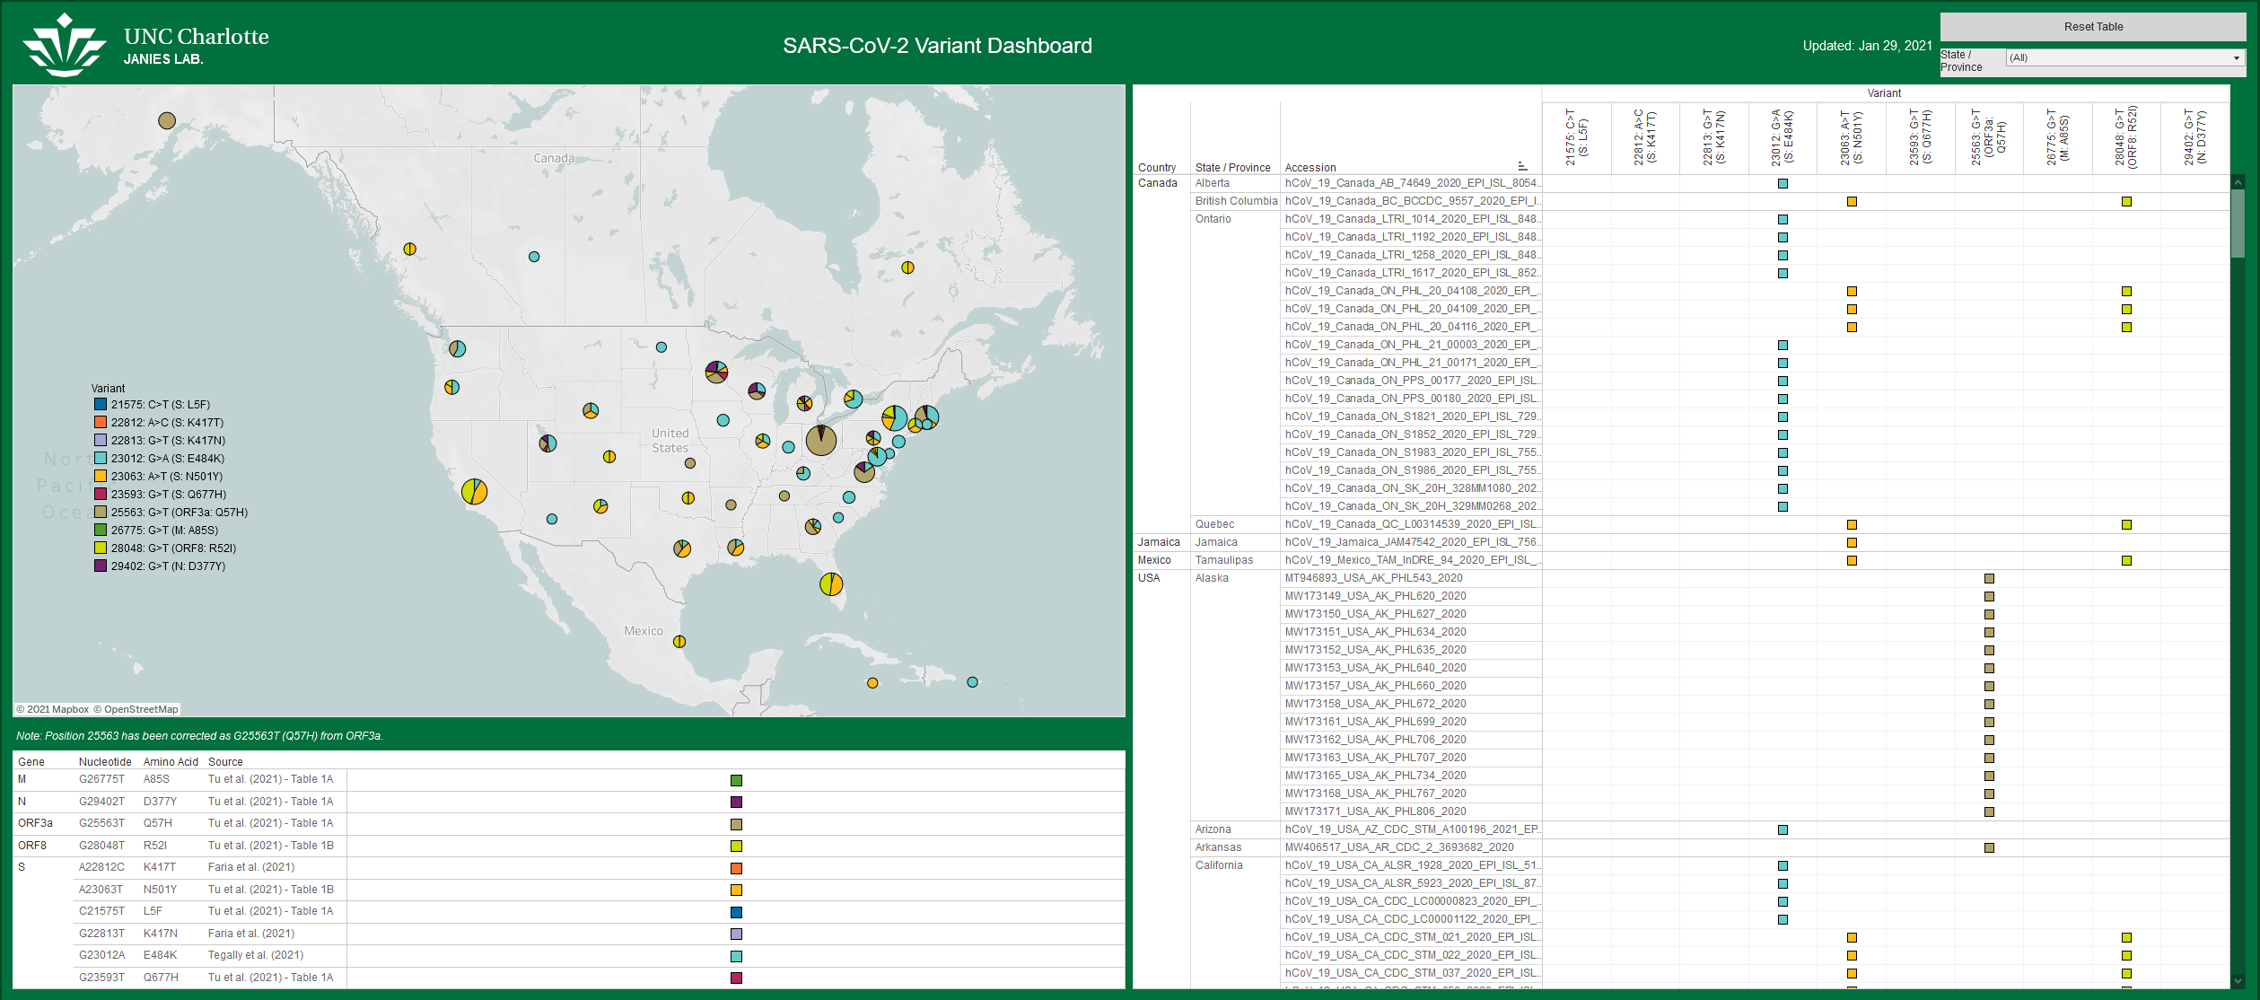
SARS-CoV-2 Variant Tracking
janieslab.github.io/sars-cov-2
Ford et al. (2021)

Slide 14
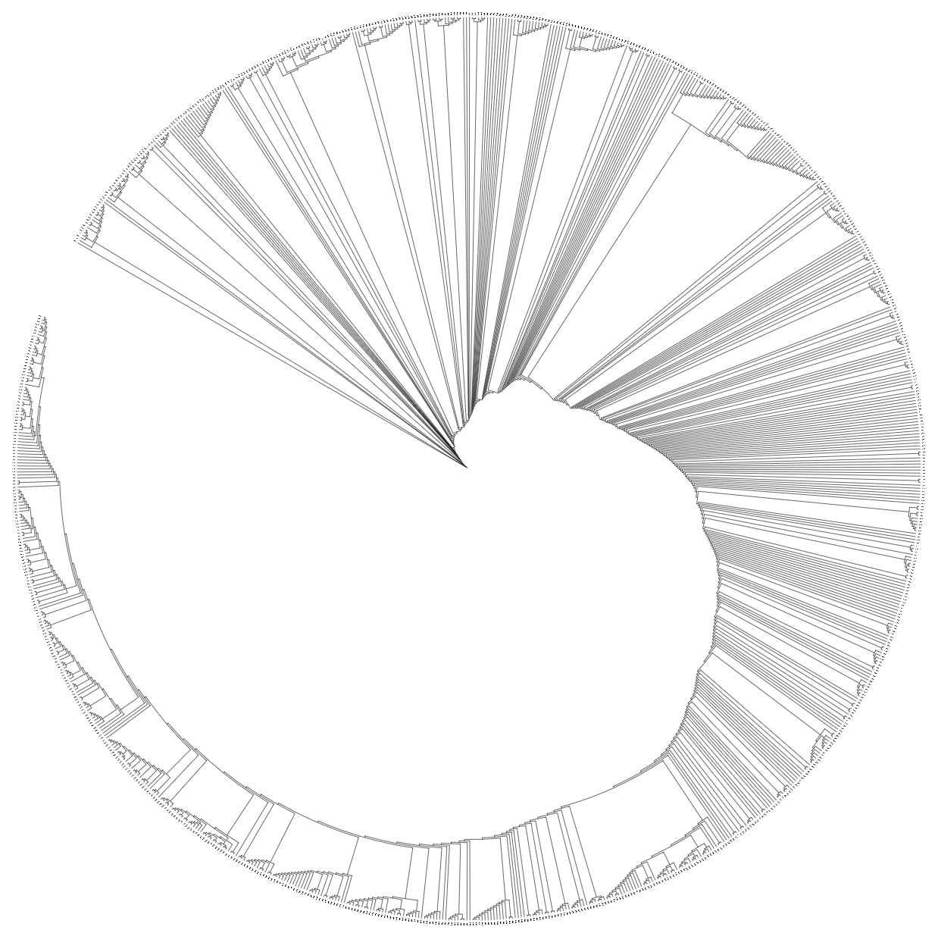
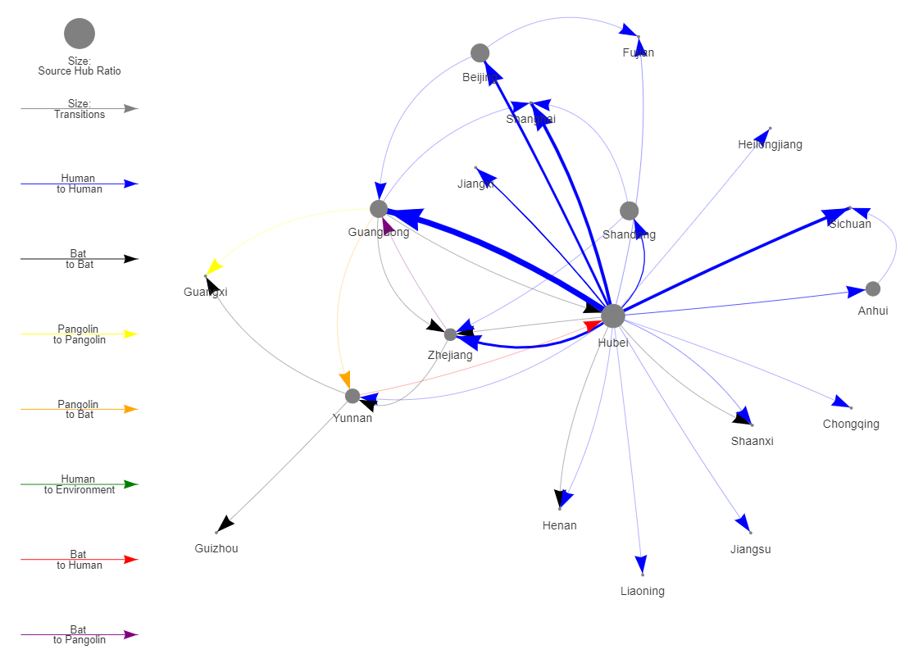


Disease Transmission Visualization
Phylogenetic
Tree
Location and Host
Metadata
StrainHub.io
Schneider and Ford et al., (2019)

Slide 15
Q&A Thank You!

